Slide 1
Tutorial 4
Java

Slide 2
Topics
Object creation
Sending messages / method invocation
Scanner
If-else examples
While loop
Math API
Assignment 2

Slide 3
Object creation
Declaring a variable to refer to an object
Scanner keyboard = null; // refers to nothing yet
Instantiating a class
The new keyword is a Java operator that creates an object.
Initializing an object
The new operator is followed by a ClassName.
Scanner keyboard = new Scanner(System.in);

Slide 4
Object creation
public class Point {
public int x = 0; // fields
public int y = 0;
// constructor, a special method for initializing a new object
public Point(int a, int b) {
x = a; // copies the argument/ local variable a TO object field x
y = b; // copies the argument/ local variable b TO object field y
}
}
How to create an object of this class?
Point originOne = new Point(23, 94); // a ← 23, b ← 94

Slide 5
Sending messages / method invocation
Firstly, declare an object variable:
ClassName objectVar;
Then, create an object and store it:
objectVar = new ClassName();
Send a message as follows:
returnValue = objectVar.methodName( parameter );

Slide 6
Scanner
You can use the Scanner next*() methods to get input from user through console.
First, create a scanner object:
Scanner keyboard = new Scanner(System.in);
System.in is the "standard" input stream source.
Typically this stream corresponds to keyboard input.

Slide 7
Scanner
Scanner next*() methods
Scanner keyboard = new Scanner(System.in);
double d = keyboard.nextDouble();
This will get the console input from user, a double value.
What will happen if I input a string rather than a number?
double | nextDouble() Scans the next token of the input as a double.
float | nextFloat() Scans the next token of the input as a float.
int | nextInt() Scans the next token of the input as an int.
String | nextLine() Advances this scanner past the current line and returns the input that was skipped.
long | nextLong() Scans the next token of the input as a long.
short | nextShort() Scans the next token of the input as a short.

Slide 8
Simple if-else examples
The if-else Statement
void applyBrakes() {
// the "if" clause: bicycle must be moving
if (isMoving) {
// the "true-case" clause: decrease current speed
currentSpeed--;
}
else {
System.err.println("The bicycle has already stopped!");
}
}

Slide 9
Full example
class IfElseDemo {
public static void main(String[] args) {
System.out.print("Input test score: ");
Scanner keyboard = new Scanner(System.in);
int testScore = keyboard.nextInt();
char grade;
if (testScore >= 90) {
grade = 'A';
} else if (testScore >= 80) {
grade = 'B';
} else if (testScore >= 70) {
grade = 'C';
} else if (testScore >= 60) {
grade = 'D';
} else {
grade = 'F';
}
System.out.println("Grade = " + grade);
}
}
The following program, an if-else demo, assigns a grade based on the value of a test score, input from the user:
an A for a score of 90% or above;
a B for a score of 80% or above; and so on.
A sample output from the program is:
Input test score: 59
Grade = F

Slide 10
While loop
Repeatedly execute statement1 as long as condition is true.
When condition is false, execute statement2.
Compare it with for loop.
condition
statement1
while (condition)
statement1;
statement2;
false
true
statement2

Slide 11
While loop example
Find all the square numbers less than n
How to solve this problem using for loop?
void printSquareNums(int n) {
int s = 1;
while (s * s < n) {
System.out.println(s * s);
s++;
}
}

Slide 12
Math function APIs
Remember to use the JAVA API Doc
https://docs.oracle.com/en/java/javase/11/docs/api/java.base/java/lang/Math.html
Some functions that could be used in assignment2
First import corresponding packages. Remember how to fix imports by NetBeans?

Slide 13
Math function APIs
static double | pow(double a, double b) Returns the value of the first argument raised to the power of the second argument, a is the base and b is the exponent.
static double | sqrt(double a)Returns the correctly rounded positive square root of a double value.
static double | log(double a)Returns the natural logarithm (base e) of a double value
static double | log10(double a)Returns the base 10 logarithm of a double value.
static double | log1p (double a)Returns the natural logarithm of the sum of the argument and 1.
double a = pow(2, 3); double b = sqrt(4);
double c = log(5); double d = log10(100);
double e = log1p(1);
System.out.println(Math.round(3.14159));

Slide 14
Assignment 2: Future Value
Aims:
To implement future value calculation for growing asset by writing a Java console application.
To practice the use of variables/expression, looping/branching statements and basic Math functions.

Slide 15
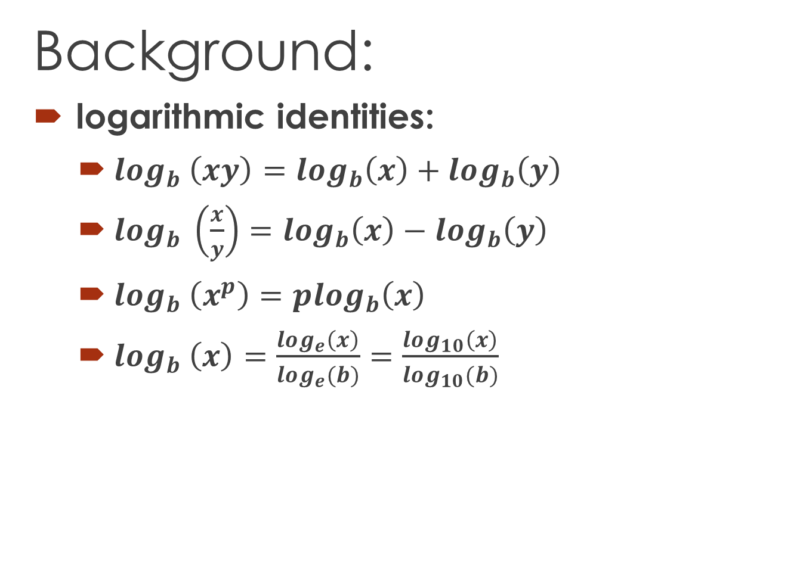
Assignment 2
Background:
logarithmic identities:
$log_{b} \left(xy\right)=log_{b}\left(x\right)+log_{b}\left(y\right)$
$log_{b} \left(\frac{x}{y}\right)=log_{b}\left(x\right)−log_{b}\left(y\right)$
$log_{b} \left(x^{p}\right)=plog_{b}\left(x\right)$
$log_{b} \left(x\right)=\frac{log_{e}\left(x\right)}{log_{e}(b)}=\frac{log_{10}\left(x\right)}{log_{10}(b)}$

Slide 16
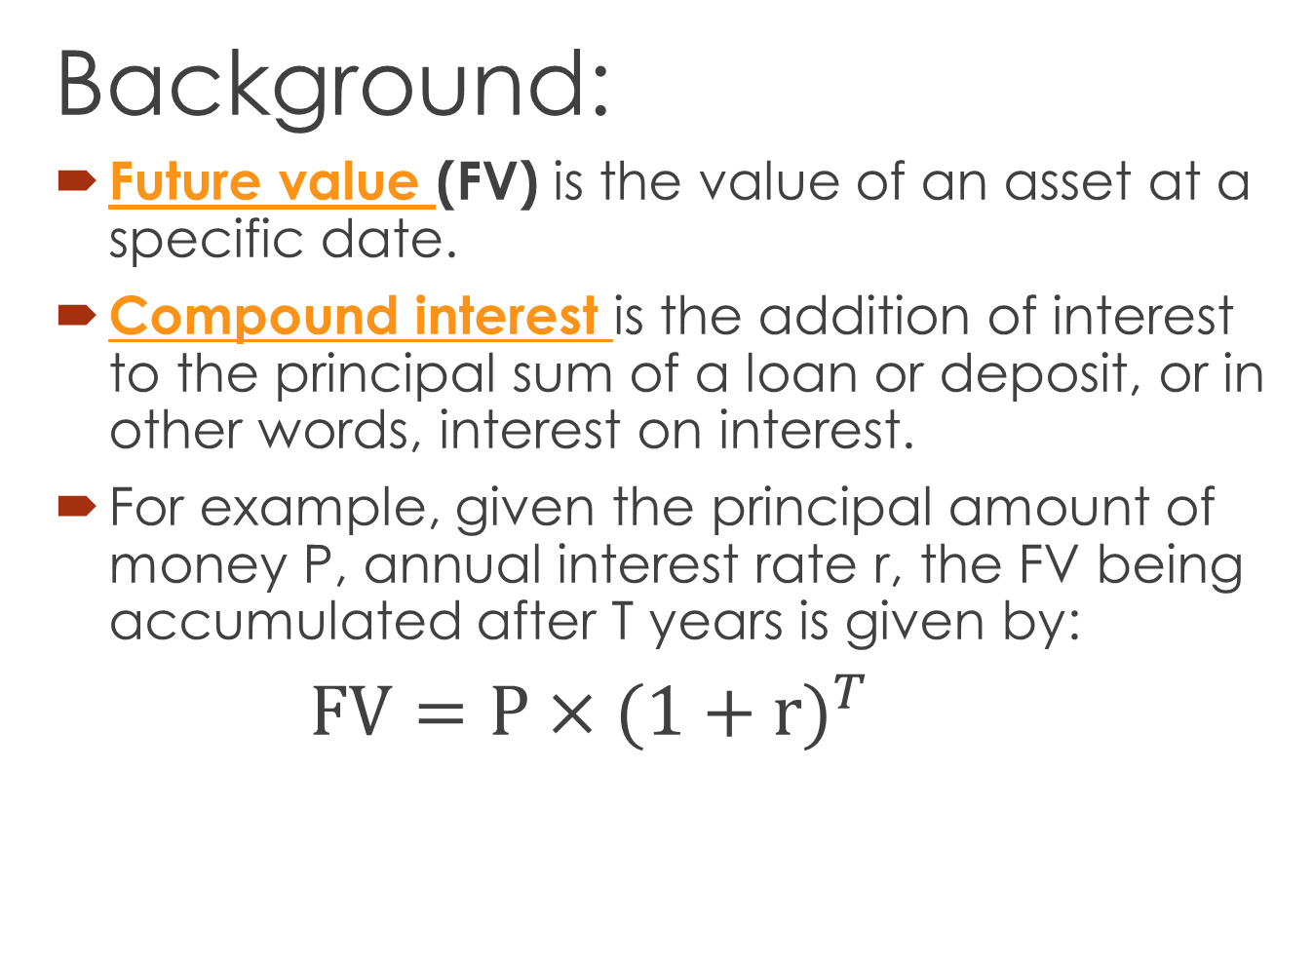
Assignment 2
Background:
Future value (FV) is the value of an asset at a specific date.
Compound interest is the addition of interest to the principal sum of a loan or deposit, or in other words, interest on interest.
For example, given the principal amount of money P, annual interest rate r, the FV being accumulated after T years is given by:
$FV=P×{(1+r)}^{T}$

Slide 17
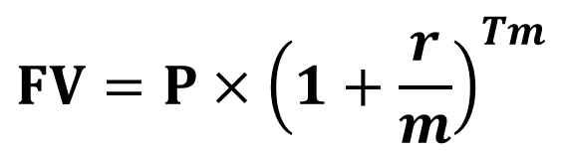
Assignment 2
Background:
In this assignment, we will use different compounding period.
m is the compounding frequency per year
$$FV=P×{\left(1+\frac{r}{m}\right)}^{Tm}$$
Notes:
So, the formula need be updated slightly.
Other parameters are the same as above.

Slide 18
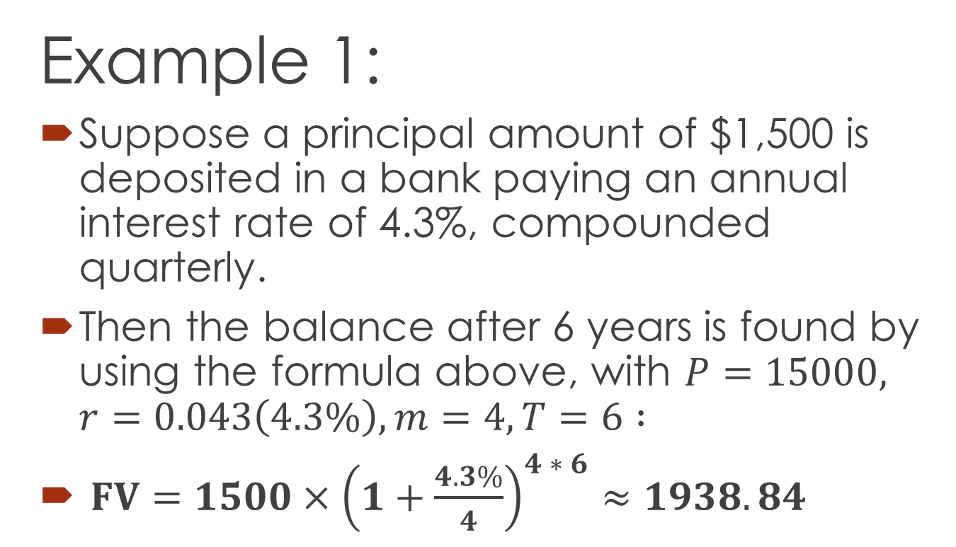
Assignment 2
Example 1:
Suppose a principal amount of $1,500 is deposited in a bank paying an annual interest rate of 4.3%, compounded quarterly.
Then the balance after 6 years is found by using the formula above, with $P=15000, r=0.043\left(4.3\%\right), m=4, T=6 :$
$FV=1500×{\left(1+\frac{4.3\%}{4}\right)}^{4 ∗ 6}≈1938.84$

Slide 19
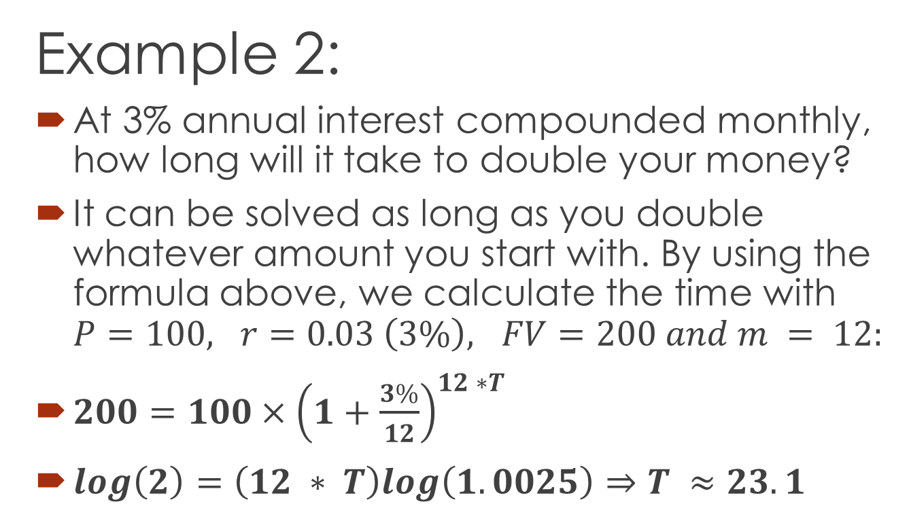
Assignment 2
Example 2:
At 3% annual interest compounded monthly, how long will it take to double your money?
It can be solved as long as you double whatever amount you start with. By using the formula above, we calculate the time with $P=100, r=0.03 \left(3\%\right), FV=200 and m = 12:$
$200=100×{\left(1+\frac{3\%}{12}\right)}^{12 ∗T}$
$log\left(2\right)=\left(12 ∗ T\right)log\left(1.0025\right)⇒T ≈23.1$

Slide 20
Assignment 2
Main Task:
You are required to write a program to perform future value calculation AND determine the time to double (×2) a given asset. You also need to round up the time to the nearest compounding period.
You are required to obtain the input from the console standard input using Scanner and System.in.

Slide 21
Assignment 2
Example:
Input Principal [$10000.00 - $109700.00]: 50000
Input Annual Interest Rate [1.0% - 10.0%]: 10
Input Timespan [2 - 10 years]: 10
Input Compounding Period [2, 3 or 6 months]: 6
Future Value after 1 year: $55125.00
Future Value after 2 years: $60775.31
...
Future Value after 10 years: $132664.89
Time to double asset: 7 years 6 months

Slide 22
Assignment 2
You are NOT required to validate the input numbers types.
However, you are REQUIRED to validate the input range.
WARNING should be given to user on invalid input and request input again until the entered value is within the range.
In the output, you shall print out the First 2 (AT MOST) and THE LAST future value.(see examples in the assignment2_FutureValue.pdf)

Slide 23
Assignment 2
You shall define one package futurevalue
and one class called FutureValue
in a new NetBeans project named FutureValue
The class shall contain a main method that performs all the operations including input, conversion and output.
Optionally, you may define more than one method in addition to the main method to carry out the calculation.

Slide 24
End

